Slide 1



Renewable energy sources in California
The Credibles

Slide 2


Roadmap
01 Introduction
02 Hand-Crafted Model
03 DataRobot Model & Comparison
04 Conclusions & Insights

Slide 3

01
Introduction

Slide 4
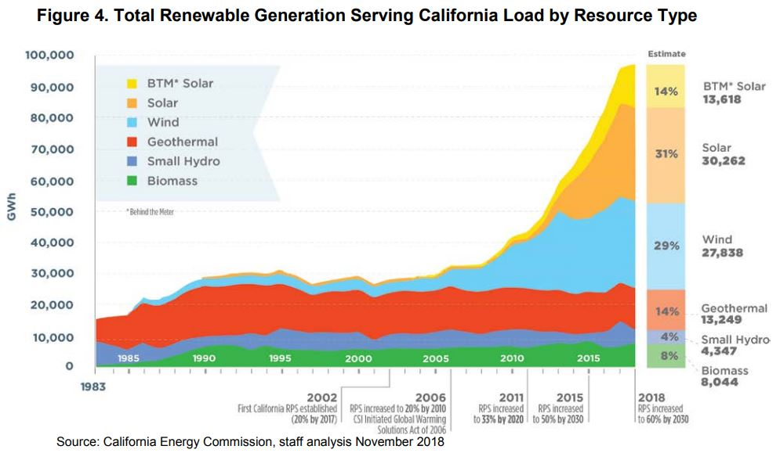
Renewable Energy In California
Add your words here，according to your need to draw the text box size。Please read the instructions and more work at the end of the manual template.
Notes:
California is a leader in green energy and has the goal of 100% zero-carbon-emissions sourced power by 2045.
The data set that this project is based on contains hourly data on the amount of energy produced from each sources of renewable energy in California, and we can see the rapid growth in renewable energy here.
The business relevance of renewable energy sources is obvious. Given emissions reduction targets there is growing demand for renewables and climate change in general is a very immediate issue.

Slide 5
Guiding Questions
Seasonality in energy production?
Complementary / non-complementary energy sources?
Valuable and practical insights for energy planners and investors
Notes:
We expected to see some seasonality in energy production that could potentially be used for better forecasting or to understand production variation.
We were also interested to see which energy sources are complementary and which are non-complementary.
We believed that to be useful to policy makers and investors, our analysis and results had to be accessible and understandable.

Slide 6

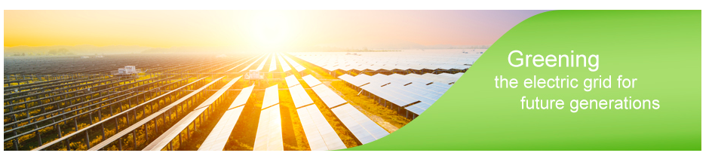
The Data
The data set is from Kaggle https://www.kaggle.com/cheedcheed/california-renewable-production-20102018
The original source is California ISO (CISO)
Highly trustworthy source!
Notes:
The data set is from Kaggle, with the original source being California ISO:
they’re an independent, power grid operator, who supply 80% of California’s power lines and we believe they are a highly reliable data source.

Slide 7
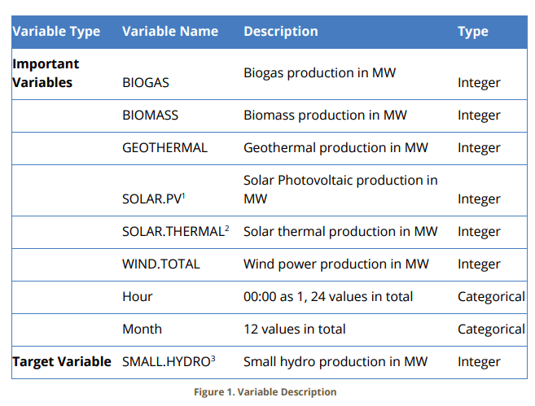
Data Preparation
Used timestamp variable to generate hour and month indicator variables to explore seasonality hypothesis
Removed SOLAR variable which contained 70% missing values
Post-preparation variables below:
Notes:
Used timestamp variable to generate hour and month indicator variables to explore seasonality hypothesis and removed a variable which contained 70% missing values
Cleaned variables shown here contained energy output by source and time:

Slide 8
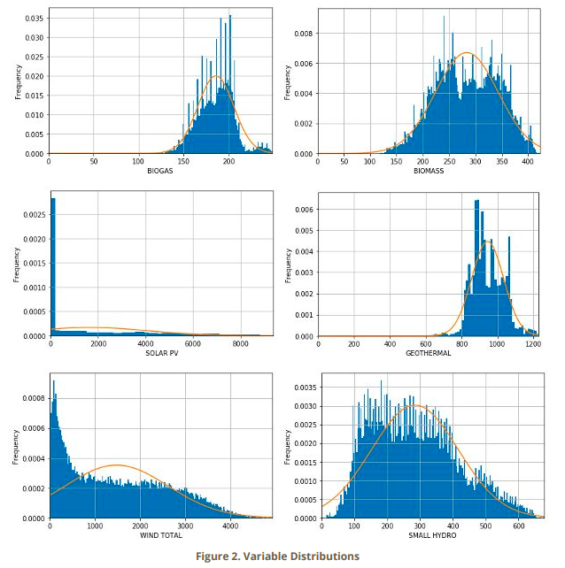
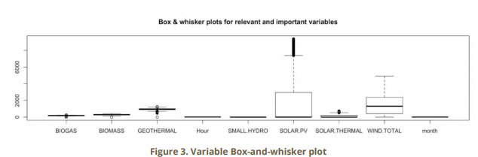
Descriptive Statistics 1
Notes:
From descriptive statistics we found that all energy variables fitted approximately well with a normal distribution, with the exception of SOLAR.PV and WIND.TOTAL.
The distributions of Solar.PV and Wind.total make sense because of the nature of the power source. Both sources experience long periods of low/no output and only produce output for short intervals each day: when the sun is out or the wind blowing, so we weren’t concerned that these distributions destroyed our data quality.

Slide 9
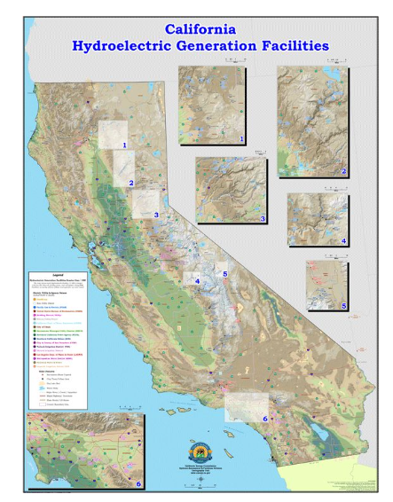
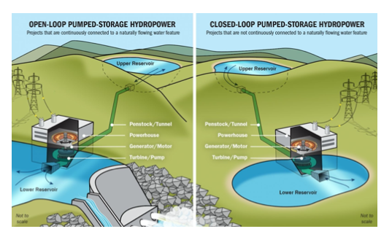
Target Variable - SMALL HYDRO - Justification:
Statistics, Policy, Economics
Statistics: Approximately normal distribution and relatively large correlation coefficients with other variables
Policy: Guide energy production to meet emissions targets in California
Economics and Environment: Evaluate effectiveness of Small Hydro production
Notes:
As the focus for our analysis we chose small hydro as our target variable, after statistical, policy and economic considerations
From the statistics side, the distribution is close to normal and it’s relatively highly correlated to the other variables.
From a policy perspective, one of the big challenges to California’s targets is energy storage. Small hydro’s pumped storage method can help a lot with this by by pumping water uphill and converting excess wind and solar energy into gravitational potential energy, until it is needed.
From an economic and environmental perspective, evaluation of the efficiency of small hydro as an energy source compared to other sources is obviously important.
So from a policy perspective it’s meaningful to figure out how other energys interact with the production of small hydro which can be a great measurement to evaluate the overall effectiveness of renewable energy.
due to these advantages, California plans to build more hydro plants. However, many professionals questioned the efficiency of hydroelectric especially small hydro. Meanwhile, some people are worrying about the environmental disruption caused by building new plants, climate advocates say, this would reduce the need to build new solar and wind farms between now and 2030 and as a result, more gas plants would continue to operate, spewing planet-warming pollution into the atmosphere. Therefore, it’s urgent to evaluate the effectiveness of small hydro itself to compare with the other renewable energy which would be extremely helpful for economic and environmental decisions.

Slide 10
02
Hand-Crafted Model

Slide 11
Dataset
Regression
Classification
The original dataset only has 9 variables and a R squared of 0.15. To improve model performance we added interaction and polynomial terms and we have overall 67 features including the target variable.
66 variables including the square, cubic and interactive terms and one 3-level categorical target variable (0- low, 1-medium, 2-high).

Slide 12
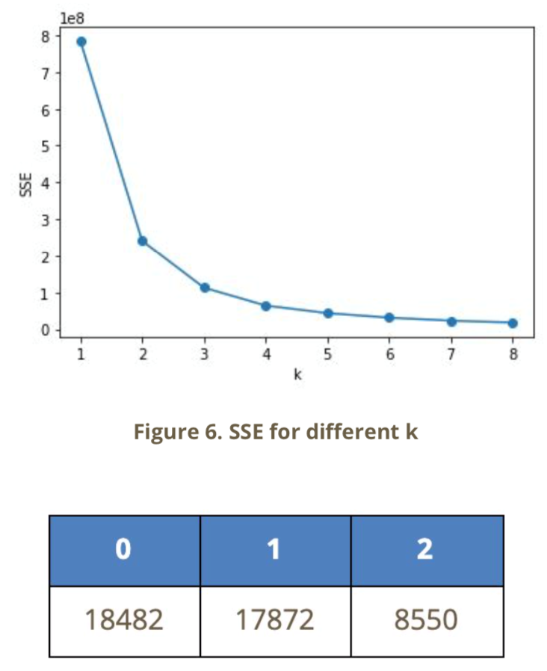
K-Means Clustering
Small Hydro | Production in MW
Low | 0-235
Medium | 236-401
High | 402-678
Low, medium high respectively have 18482, 17872 and 8550 observations each. The interval for low level is 0-235, for Medium 236-401, and for High 402-678.

Slide 13
Hand-Crafted Model
Linear regression | R-squared
Backward | 0.5087
Forward | 0.5082
Exhaustive | 0.5085
Regression
Categorical Model | Testing Accuracy
Random Forest | 84.21%
KNN | 79.76%
Classification

Slide 14
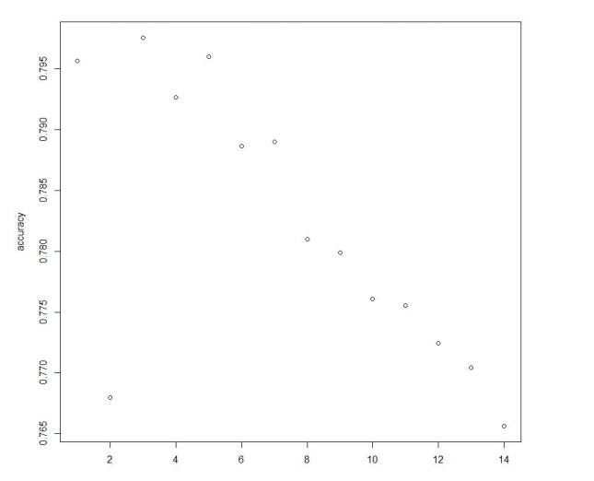
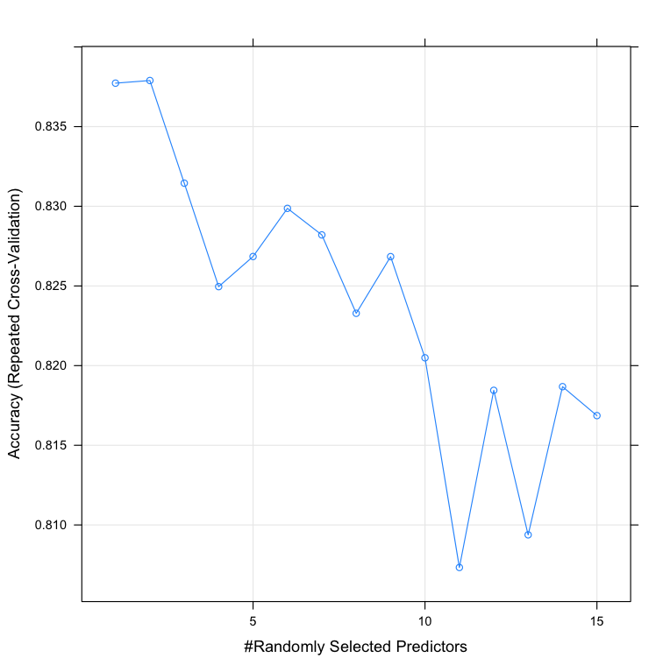
Grid Search
KNN
Random Forest
We used grid search to find the best K. The accuracy plot shows that when k equals 3, this classification performs the best
We used grid search to find the best mytry. The accuracy plot shows that when mytry equals 2, this classification performs the best

Slide 15
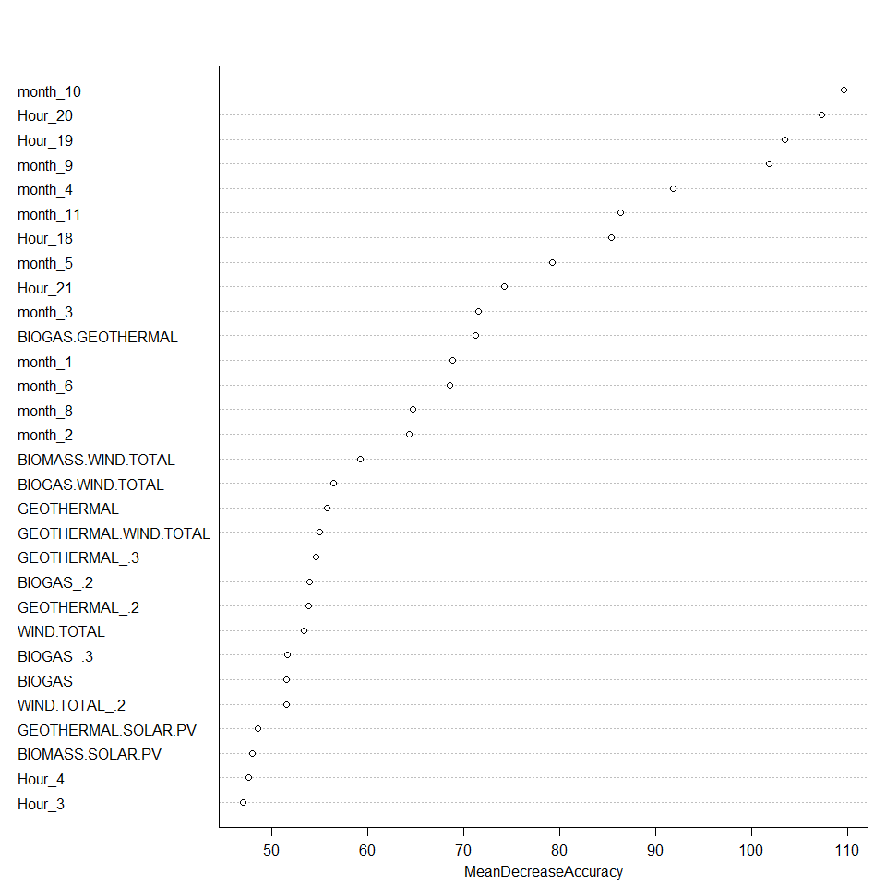
Feature Importance
Random Forest
month_10, hour_20, hour_19 are the 3 most important features in the random forest model.

Slide 16
03
DataRobot Model
& Comparison

Slide 17
Dataset
Regression
Classification
the dataset we uploaded is the same as the one we conducted our own models which contains 67 numerical variables including the target. We let DataRobot do further feature engineering.
66 numerical variables including the square, cubic and interactive terms and one 3-level categorical target variable (1- high, 2-low, 3-medium).

Slide 18
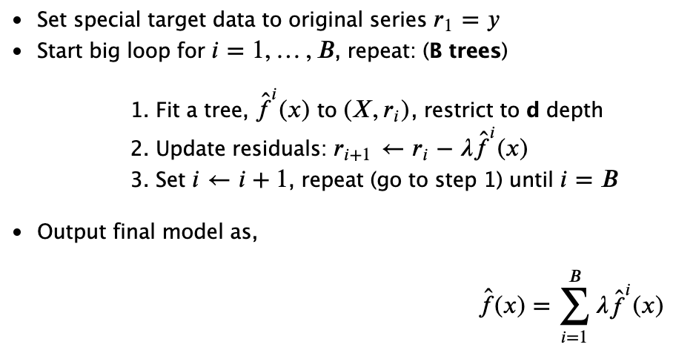
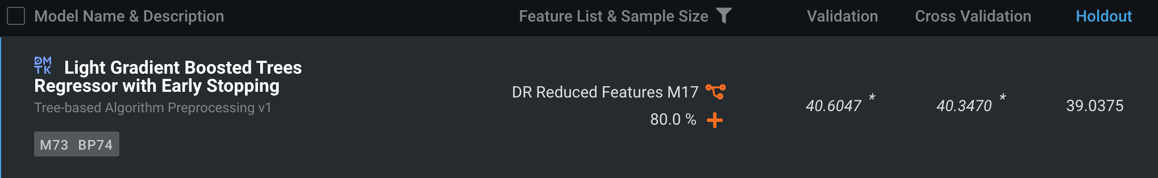
DataRobot Model
Light Gradient Boosted Trees Regressor with Early Stopping
Ensembling technique
Early stopping is used to determine the best number of trees where overfitting begins
It is a cutting-edge algorithm for fitting extremely accurate predictive models.
.
Variables: 34 variables DataRobot recommended
Training (80%) and holdout dataset (20%)
Best Model: Light Gradient Boosted Trees Regressor with Early Stopping
RMSE of 39, R square 0.91
Regression
Target Leakage
Overfitting
Notes:
Gradient boosting is an ensembling technique where several weak learners (regression trees) are combined to yield a powerful single model, in an iterative fashion.
Early stopping support enables us to find the least number of iterations which is sufficient to build a model that generalizes well to unseen data.

Slide 19
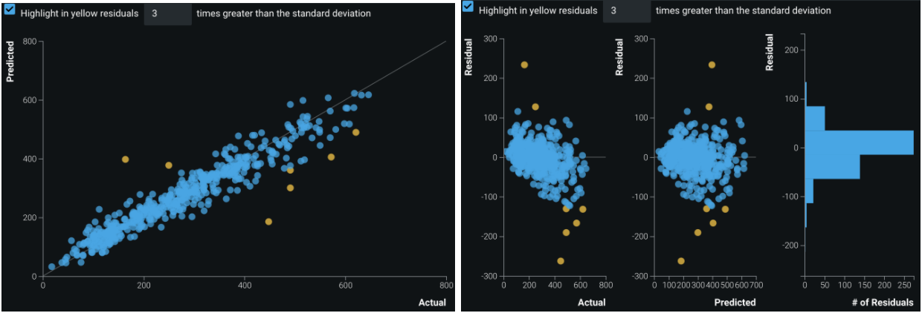
DataRobot Model - Regression
Residual Plot for LightGBM Tree
Outliers

Slide 20
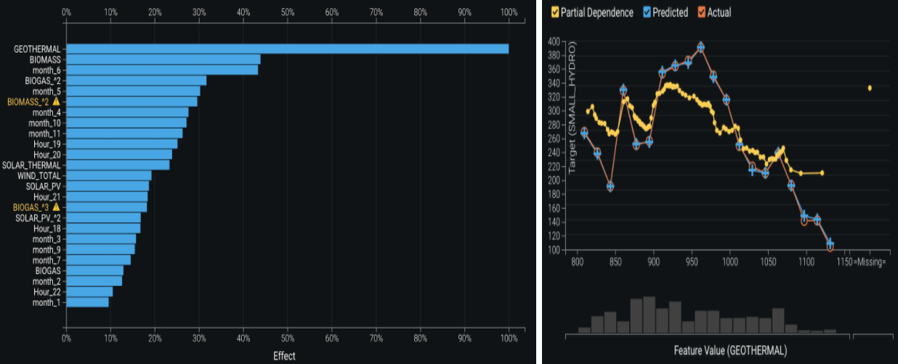
DataRobot Model - Regression
Feature Impact & Feature Effect - Partial Dependence Plot - LightGBM Tree
Notes:
found geothermal, biomass and month_6 are the most impactful to the model . Also, from the Partial Dependence Plot of geothermal, we can see how changes in the values of geothermal affects the model’s predictions.

Slide 21
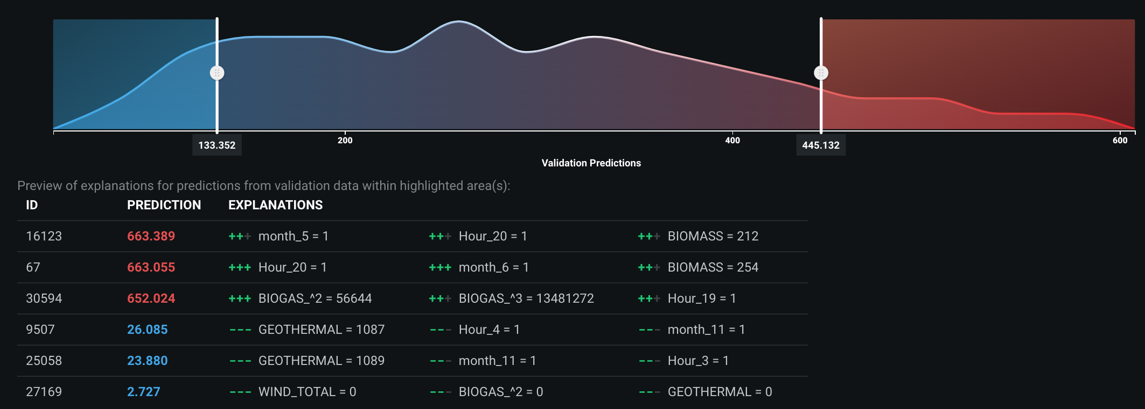
DataRobot Model - Regression
Prediction Explanations - LightGBM Tree
Notes:
we can see the top 3 explanations of high or low prediction, and for high predictions, month_5, month_6, hour_20, BIOGAS and BIOMASS are the largest contributors, while GEOTHERMAL, month_11, hour_4, and hour_3 are largest contributors for low predictions.

Slide 22
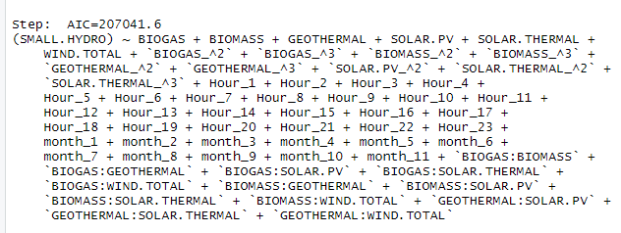
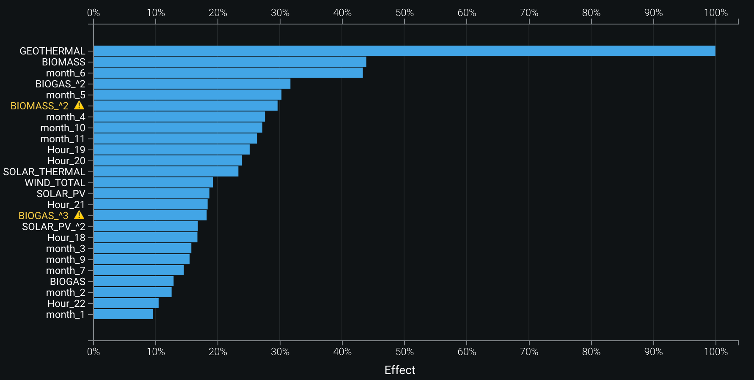
Comparison
Hand-crafted | DataRobot
Multi-linear Regression | LightGBM Regressor
R square 0.51 RMSE 89.9 | R square 0.91 RMSE 39.0
Performance
Feature selection: 61 variables
Feature selection: 34 variables, most important features based on feature impact scores
Hand-crafted
DataRobot
Feature impact: hour_11- hour_14
Feature impact: GEOTHERMAL, BIOMASS, month_6

Slide 23
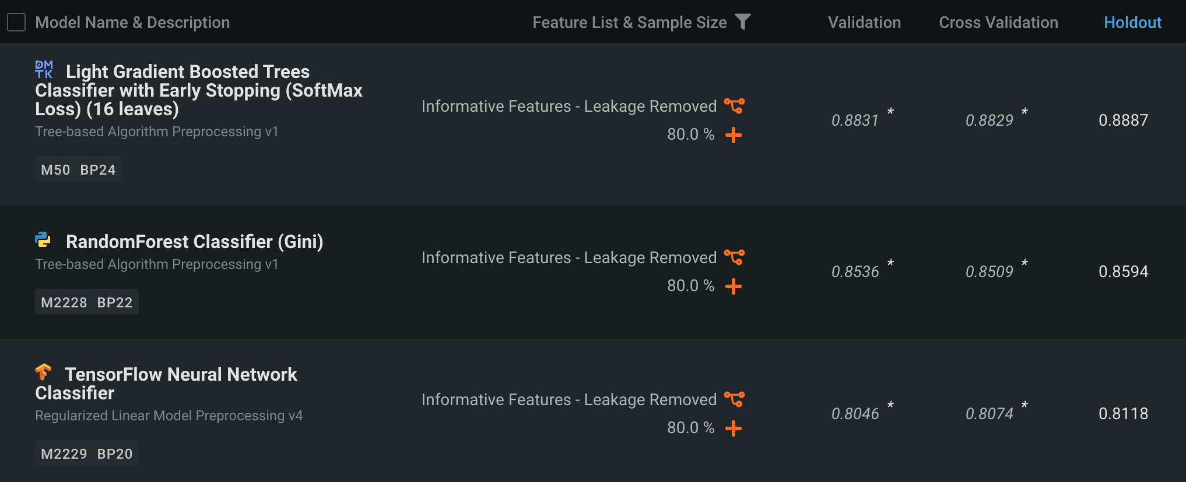
DataRobot Model- Classification
Random Forest Classifier
Ensemble method
Bootstrap train samples
Max_features
Hard to over-fit, are very accurate, generalize well, and require little tuning
Variables: 66 variables DataRobot provides removed data leakage variables
Training (80%) and holdout dataset (20%)
Best Model: Light Gradient Boosted Trees Classifier with Early Stopping (88.9%), Random Forest Classifier (85.9%)
Classification
Target Leakage
Overfitting
Notes:
ensemble method where hundreds (or thousands) of individual decision trees are fit to bootstrap re-samples of the original dataset, with each tree being allowed to use a random selection of 1- N variables
all of which are desirable properties in a predictive algorithm
.

Slide 24
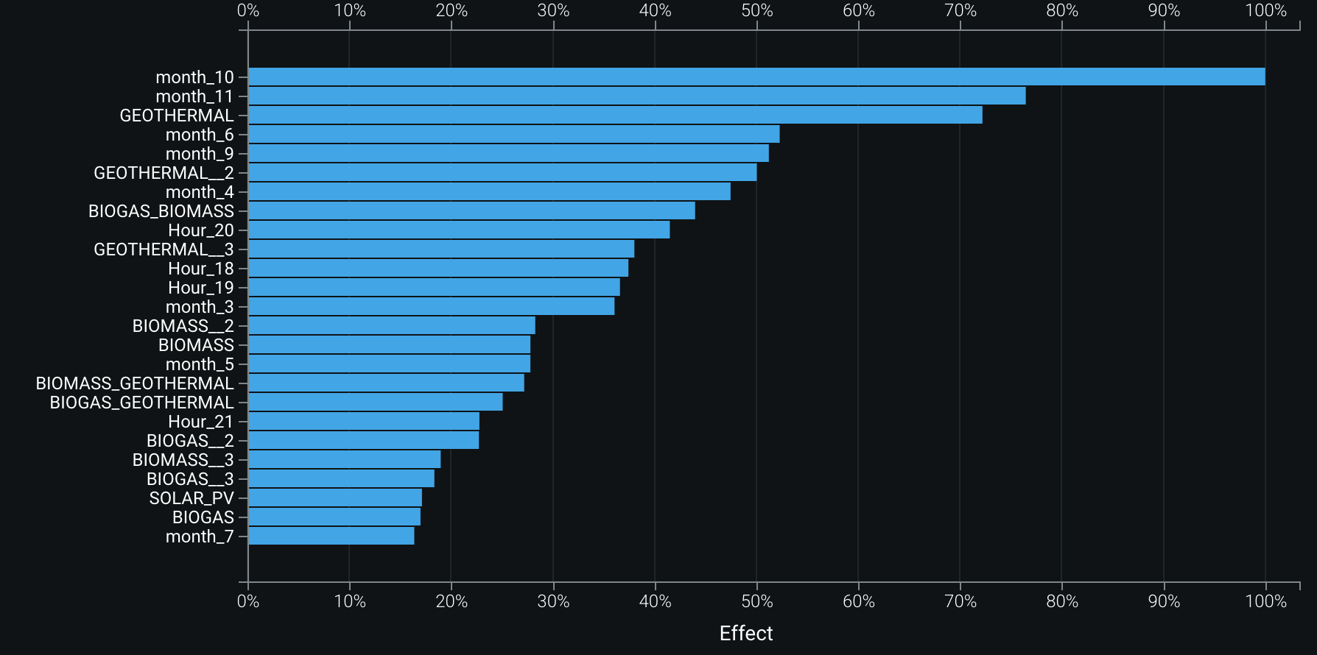
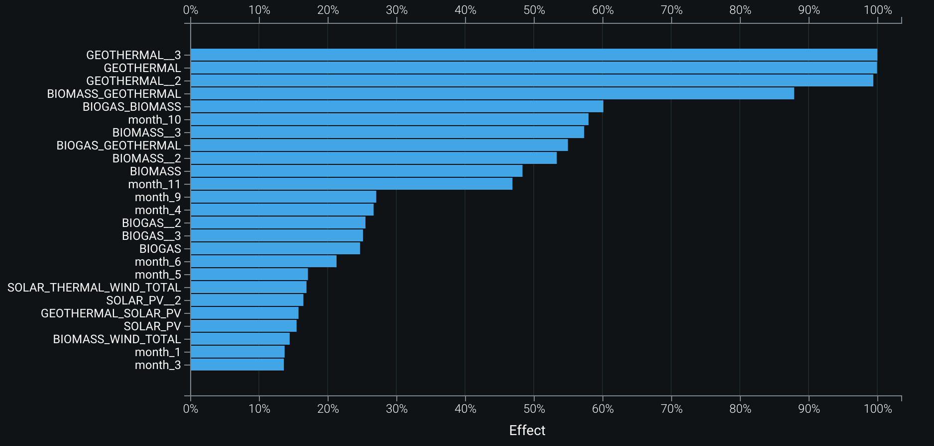
DataRobot Model - Classification
month_10, month_11 and GEOTHERMAL (including square and cubic forms) are the top influencers.
Feature impact for aggregate classes - Random Forest
Feature impact for aggregate classes - LightGBM Tree
The correlation between small hydro and geothermal is quite high and we are not sure whether this is a coincidence.

Slide 25
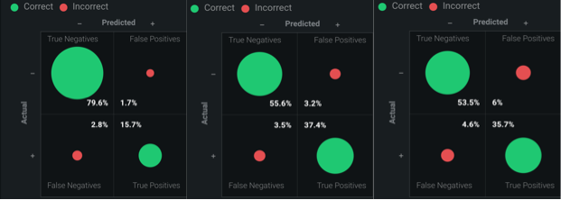
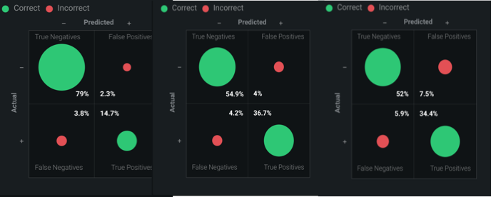
DataRobot Model - Classification
Confusion Matrix from level 1-3 - LightGBM Tree
Confusion Matrix from level 1-3 - Random Forest
 | LightGBM Tree |  |  | Random Forest
Class | High | Low | Medium | High | Low | Medium
F1 Score | 87% | 92% | 87% | 82% | 90% | 84%
Recall | 85% | 91% | 88% | 79% | 90% | 85%
Precision | 90% | 92% | 86% | 86% | 90% | 82%
From the confusion matrix and the related scores we can see the performance of both models are good, and their predictability of the 2 (low) level is slightly better.

Slide 26
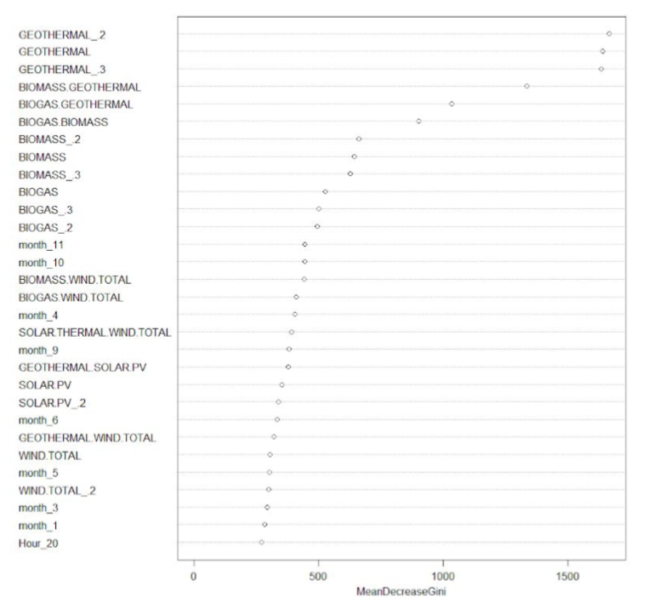
Comparison
 | Hand-crafted |  | DataRobot
Model | Random Forest | KNN | Random Forest | LightGBM Tree
Accuracy | 84.21% | 79.76% | 85.90% | 88.90%
Performance
Feature selection: 66 variables
Feature selection: 66 variables
Hand-crafted
DataRobot
Feature impact: GEOTHERMAL, GEOTHERMAL_2, GEOTHERMAL_3
Feature impact: GEOTHERMAL, GEOTHERMAL_2, GEOTHERMAL_3

Slide 27

Comparison
 | Classification |  | Regression
Hand-Crafted | Random Forest | KNN | Multi-linear Regression
Accuracy | 84.21% | 79.76% | R square 0.51 RMSE 89.9
DataRobot | Random Forest | LightGBM Tree | LightGBM Regressor
Accuracy | 85.90% | 88.90% | R square 0.91 RMSE 39.0
High accuracy
Convenient for feature engineering
Hand-crafted
Efficient, user friendly, run many models at the same time
More feasible
Can get control of each step
Better understand of the comprehensive process
Easy to tune parameters and rerun the models
Good evaluation dashboard
DataRobot
Not convenient for data wrangling
Limited application to unsupervise learning
Notes:
DataRobot models have higher accuracy compared to our models, but the gap is not large except for the regression, and multi-linear regression may not be the appropriate model for this task. The feature impact of our model is highly related to DataRobot models, especially the month variables which shows a seasonal pattern

Slide 28
04
Conclusions & Insights

Slide 29
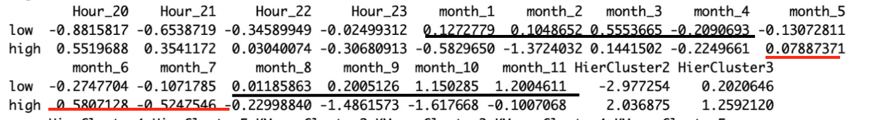
Seasonality in energy production
Logistic Regression result
The output of small hydro energy is higher during summer and lower during winter.

Slide 30
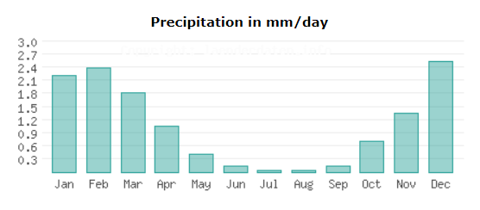
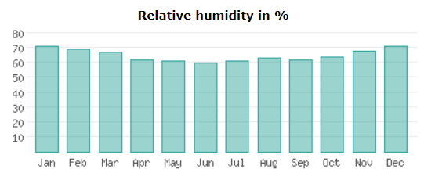
Seasonality in energy production
Low Precipitation during summer
Relative humidity is similar for the whole year
Notes:
During summer, regions of Mediterranean climate are strongly influenced by the subtropical ridge which keeps atmospheric conditions very dry with minimal cloud coverage. In some areas, such as coastal California, the cold current has a stabilizing effect on the surrounding air, further reducing the chances for rain, but often causing thick layers of marine fog that usually evaporates by mid-day.

Slide 31
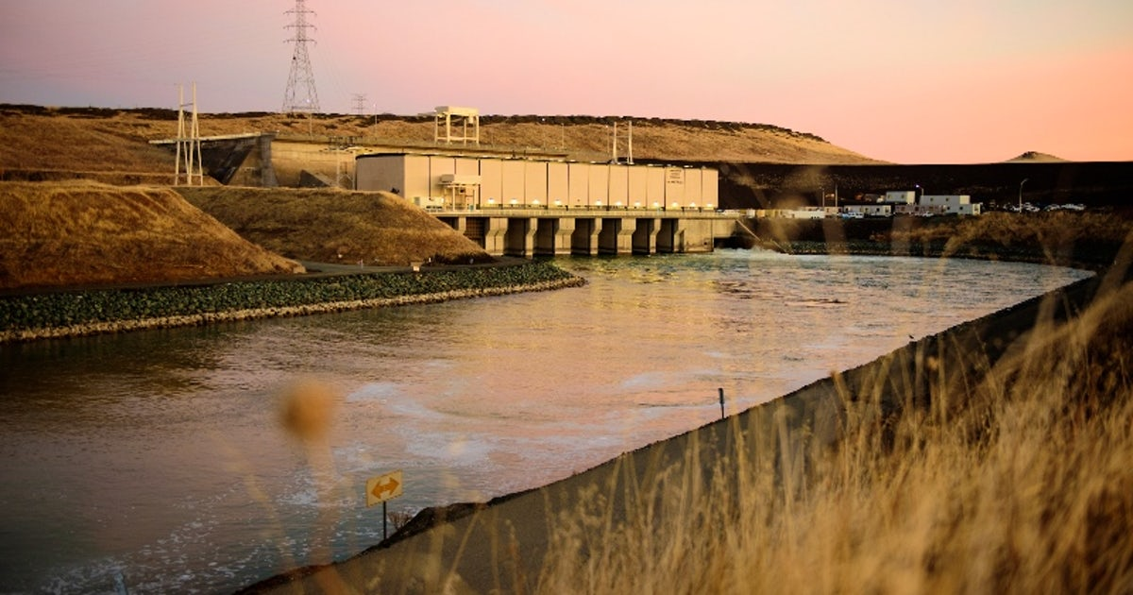
Seasonality in energy production
Most of the small hydro facilities in California locates surround irrigation districts’ canal where water moves sufficient force to spin a turbine.
Electricity is generated during peak demand periods by releasing the pumped water from the higher reservoir

Slide 32
THANK YOU

